Slide 1

مبادره رواد مصر الرقميه Track : FULL STACK.NET
Project Name :
NAJMABookStore
BY:
Nourhan Hamed Anasimon Samir
Manal Hamdy Aliaa Ali
Jasmin eshak
Instructor: Ahmad Hafez
Training company: AMIT

Slide 2
Appreciation Letter
We would like to express our sincere appreciation to the team behind the Digital Egypt Pioneers Initiative for their exceptional efforts in delivering a well-structured and impactful learning experience.Joining the Fullstack ASP.NET track has been a transformative step in our professional journey. The technical training provided a strong foundation in modern software development practices, while the additional components of the initiative added significant value.The workshops in Business English enhanced our ability to communicate confidently in international work environments. The Soft Skills sessions improved our interpersonal abilities, enabling us to handle clients and projects with greater professionalism. The Freelancing Skills training opened doors to global markets by teaching us how to build personal brands, write persuasive proposals, and navigate freelance platforms. Finally, the Career Coaching phase offered critical guidance during the practical implementation stage, from portfolio building to real project applications.This initiative has truly empowered us with the tools and confidence needed to thrive in the digital and freelance economy.Thank you once again for your dedication and support.Warm regards,
Team NAJMA

Slide 3

Project Introduction
BookStore is a modern and interactive web application designed for browsing, viewing, and purchasing books online. The platform ensures an engaging user experience through a clean layout and intuitive navigation. It is built using ASP.NET Core 7 and follows industry standards for scalability and security.
The platform enables users to browse a wide range of books, filter by categories, and view detailed descriptions for each book. With a secure login system and easy-to-use cart, the application provides a seamless shopping experience.
Administrators can manage the entire book catalog, user roles, and order tracking via a robust admin dashboard. This ensures both flexibility and control over the bookstore’s operations.

Slide 4

Project Objectives
1-Build Enable users to browse, search, and purchase books easily through an intuitive and respOnsive interface that works across devices.
2-Allow administrators to manage book inventory, categories, and customer orders through a powerful dashboard with full control over the content.
3-Provide secure user registration and login functionality, ensuring data protection and preventing unauthorized access.
4-Support role-based access control, allowing different user privileges for customers and administrators.
5-Lay the foundation for future scalability, enabling the platform to expand by integrating payment gateways, reviews, and other advanced features later on.
6-a functional and user-friendly online bookstore that provides a seamless experience for both customers and administrators.

Slide 5
Main Features
Book browsing with search and filtering options.
Detailed view for each book.
User registration and login system.
Admin dashboard to manage categories, books, and orders.

Slide 6
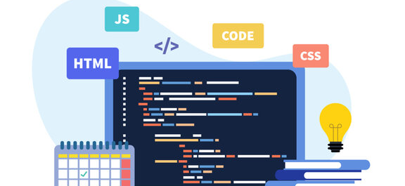

Technologies used
Front-End: HTML CSS JavaScript BootStrap Back-End C# ASP.NET Core (7) MVC Pattern MS SQL Server design patterns Repository Pattern unit of work Pattern Dependency injection

Slide 7
Architecture
N-Tier Architecture to separate concerns.
Clear separation between Data, Business Logic, and UI layers.
Dependency Injection for better testability and flexibility.

Slide 8
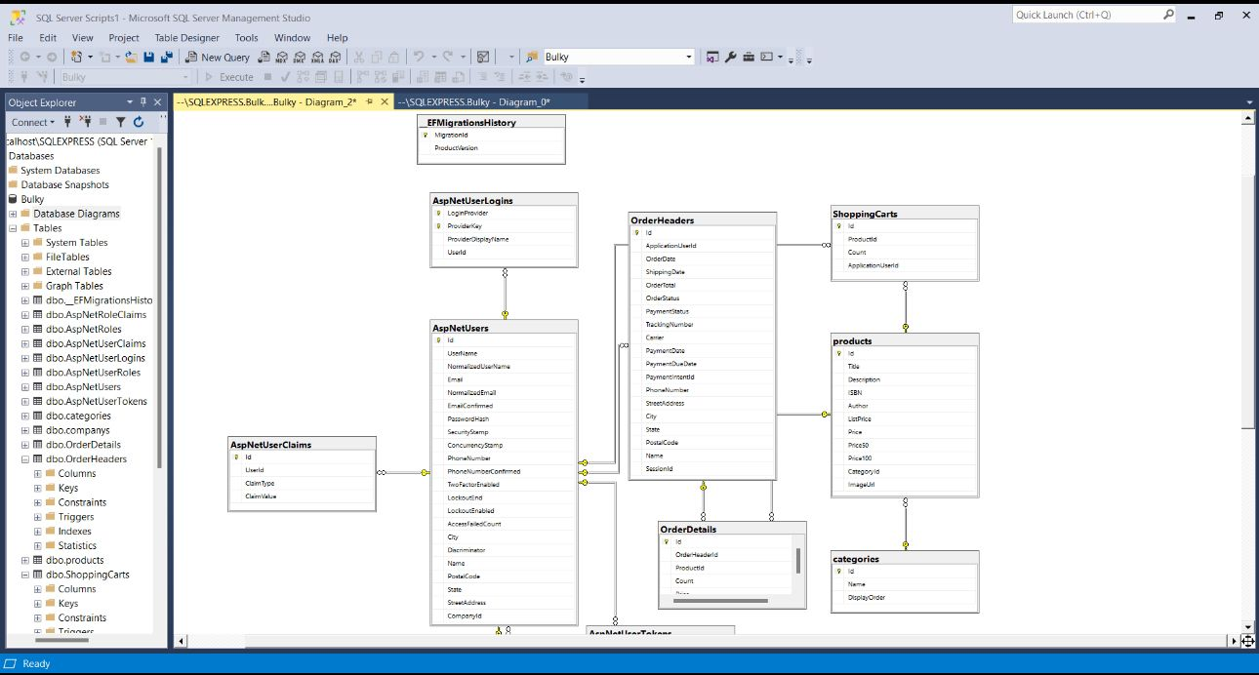
ERD

Slide 9
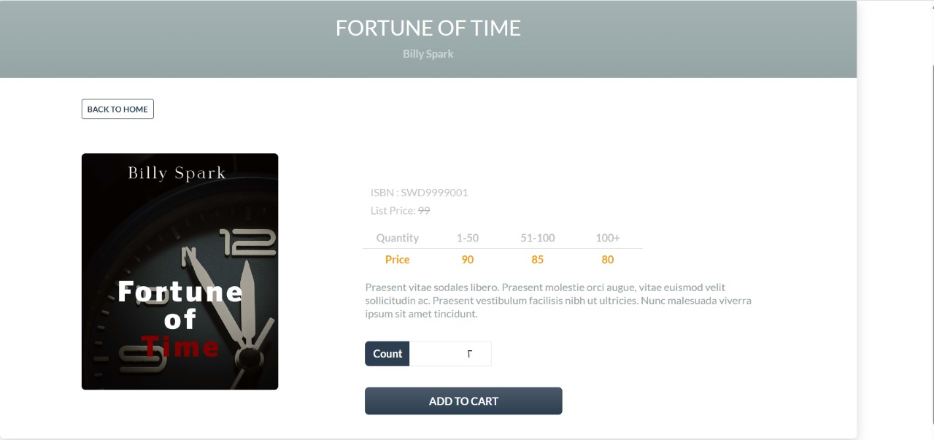

Slide 10
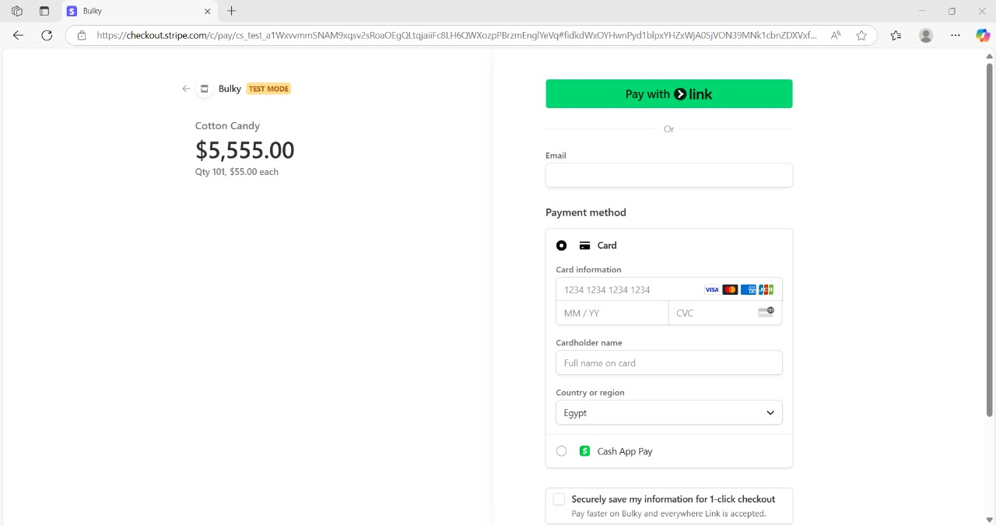

Slide 11
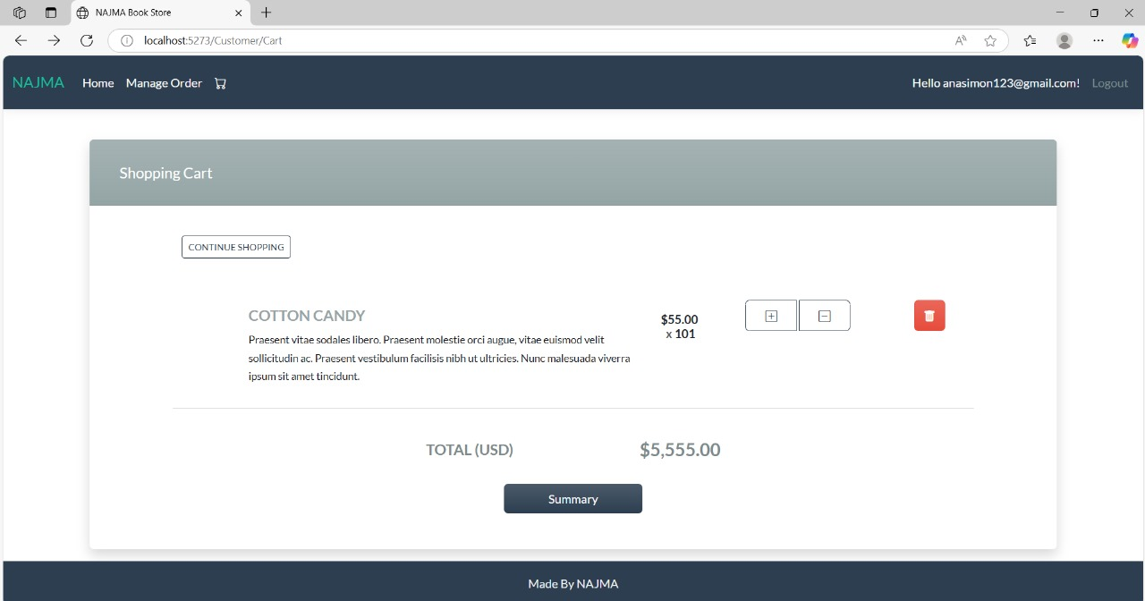

Slide 12

Special thanks to the “DEPI”initiative for their support and encouragement.
We are grateful for the opportunity to learn and build practical projects.

